Slide 1
www.education-enriched.co.uk
Terms and conditions of use
You may print this document for your personal use but please remember
that it is the property of Education Enriched Limited and is not to be used for
commercial use under any circumstances.. Jazaakum Allahu khayraa!
If you have any suggestions or feedback, please feel free to email us
at rskhan@education-enriched.co.uk.

Slide 2
Prophet Muhammad ﷺ
Prophet Muhammad ﷺ
Prophet Muhammad ﷺ
Prophet Muhammad ﷺ
©Education Enriched 2018

Slide 3
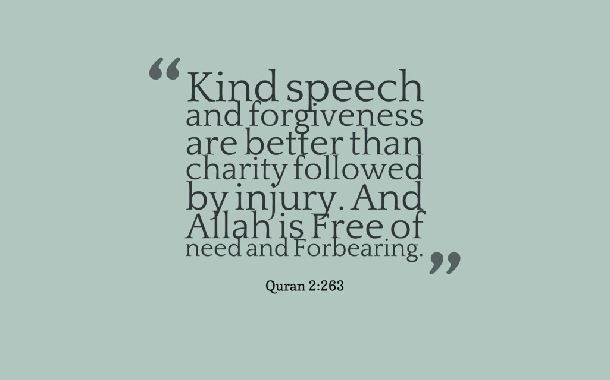
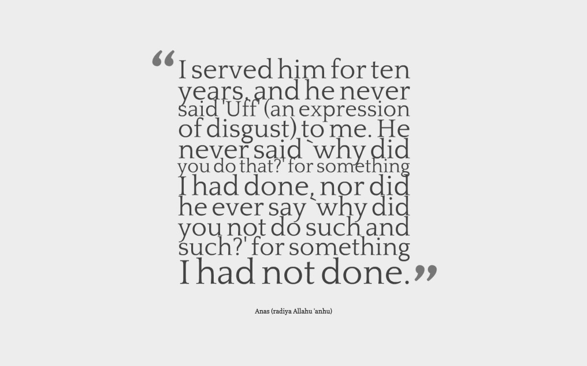
Qur’an 2:263
Prophet Muhammad ﷺ
Prophet Muhammad ﷺ
Prophet Muhammad ﷺ
©Education Enriched 2018

Slide 4
©Education Enriched 2018

Slide 5
©Education Enriched 2018

Slide 6
©Education Enriched 2018

Slide 7
©Education Enriched 2018

